Slide 1

Mitigation in a Modern World
or
33 CFR 332 and You
Presented by Jayson M Hudson
To the Texas Association of Environmental Professionals
May 20, 2010

Slide 2
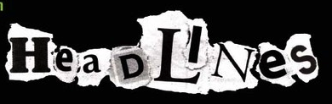
On April 10, 2008, EPA and the U.S. Army Corps of Engineers issued revised regulations governing compensatory mitigation for authorized impacts to wetlands, streams, and other waters of the U.S. under Section 404 of the Clean Water Act.
These regulations were designed to:
  Improve the effectiveness of compensatory mitigation to replace lost aquatic resource functions and area,
  Expand public participation in compensatory mitigation decision making,
  Increase the efficiency and predictability of the mitigation project review process.

Slide 3
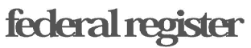
COMPENSATORY MITIGATION FOR LOSSES OF AQUATIC RESOURCES
33 CFR Part 332 (U.S. Army Corps of Engineers)
40 CFR Part 230 (Environmental Protection Agency)
&
Regulatory Guidance Letter 08-03 - Minimum Monitoring Requirements for Compensatory Mitigation Projects Involving the Restoration, Establishment, and/or Enhancement of Aquatic Resources.

Slide 4
Oh, and 33 CFR 325 too…
This is the section that describes how to apply for a permit.
Amend 325.1 by redesignating paragraphs (d)(7), (d)(8), and (d)(9) as paragraphs (d)(8), (d)(9), and (d)(10), respectively, and adding new paragraph(d)(7) as follows:
For activities involving discharges of dredged or fill material into waters of the United States, the application must include a statement describing how impacts to waters of the United States are to be avoided and minimized. The application must also include either a statement describing how impacts to waters of the United States are to be compensated for or a statement explaining why compensatory mitigation should not be required for the proposed impacts
The application is considered incomplete without this information and the permit will not be processed until this is information is provided.

Slide 5
What Did the New Rule Replace?
1995 Federal Guidance for the Establishment, Use, and Operation of Mitigation Bank
2000 Federal Guidance on the Use of In-Lieu Fee Arrangements for Compensatory Mitigation Under Section 404 of the Clean Water Act and Section 10 of the Rivers and Harbors Act
Regulatory Guidance Letter 02-02, Guidance on Compensatory Mitigation Projects for Aquatic Resource Impacts Under the Corps Regulatory Program Pursuant to Section 404 of the Clean Water Act and Section 10 of the Rivers and Harbors Act of 1899
The provisions relating to the amount, type, and location of compensatory mitigation projects, including the use of preservation, in the February 6, 1990, Memorandum of Agreement (MOA) between the Department of the Army and the Environmental Protection Agency on the Determination of Mitigation Under the Clean Water Act Section 404(b)(1) Guidelines

Slide 6
What The Rule Didn’t Change
Mitigation Sequencing required in the 404(b)(1) Guideline:
  avoidance, minimization then compensation
General Mitigation Policy found in 33 CFR 320.4(r)
  project modification, 404(b)(1) sequencing and public interest review concerns
Jurisdiction
  Jurisdiction changes so much I wanted to make sure you knew this new rule didn’t change jurisdiction

Slide 7
What is in the New Rule?
53 Definitions
Watershed Approach
Preference Hierarchy
Mitigation Plan Requirements
Mitigation Bank and In-lieu Fee Approval Process

Slide 8
Important New \de-fə-ˈni-shəns\
Enhancement means the manipulation of the physical, chemical, or biological characteristics of an aquatic resource to heighten, intensify, or improve a specific aquatic resource function(s). Enhancement results in the gain of selected aquatic resource function(s), but may also lead to a decline in other aquatic resource function(s). Enhancement does not result in a gain in aquatic resource area.
Establishment (creation) means the manipulation of the physical, chemical, or biological characteristics present to develop an aquatic resource that did not previously exist at an upland site. Establishment results in a gain in aquatic resource area and functions.
Preservation means the removal of a threat to, or preventing the decline of, aquatic resources by an action in or near those aquatic resources. This term includes activities commonly associated with the protection and maintenance of aquatic resources through the implementation of appropriate legal and physical mechanisms. Preservation does not result in a gain of aquatic resource area or functions.

Slide 9
Important New Definitions cont
Restoration means the manipulation of the physical, chemical, or biological characteristics of a site with the goal of returning natural/historic functions to a former or degraded aquatic resource. For the purpose of tracking net gains in aquatic resource area, restoration is divided into two categories: re-establishment and rehabilitation.
  Re-establishment means the manipulation of the physical, chemical, or biological characteristics of a site with the Re- establishment results in rebuilding a former aquatic resource and results in a gain in aquatic resource area and functions.
  Rehabilitation means the manipulation of the physical, chemical, or biological characteristics of a site with the Rehabilitation results in a gain in aquatic resource function, but does not result in a gain in aquatic resource area.

Slide 10

Wait…what?
Function is defined in the rule to mean the physical, chemical, and biological processes that occur in ecosystems.
To date, the “no net loss policy” is interpreted in acres and does not compare the functions and values of wetlands gained and lost
These new definitions discuss area and function, in some cases allowing for mitigation resulting in no gain in area to be compensation.
Does enhancement or rehabilitation meet the spirit of “no net loss”?

Slide 11
Subvert the Dominant Paradigm
The objective of the Clean Water Act (CWA) is to restore and maintain the chemical, physical, and biological integrity of the Nation’s waters.
In other words, the functional integrity of the nations water
If we measure the function lost by a permitted activity, and compensate for those functions in the same watershed…

Slide 12

But what about Preservation?
Preservation does not result in a gain of aquatic resource area OR functions.
When is it allowed?
  Limited to resources that provide important functions for the watershed and
  Contribute significantly to the ecological sustainability of the watershed and
  The resources are under an unregulated threat of destruction or adverse modification.

Slide 13
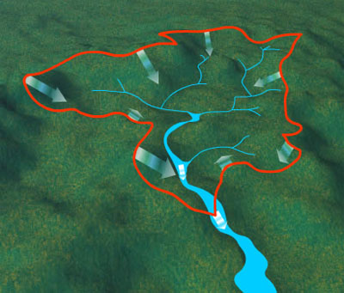
Watershed Approach
Defined as the analytical process for making compensatory mitigation decisions that support the sustainability or improvement of aquatic resources in a watershed by identify the types and locations of compensatory mitigation projects that will benefit the watershed and offset losses of aquatic resource functions
Includes:
  consideration of landscape scale,
  historic and potential aquatic resource conditions,
  past and projected aquatic resource impacts in the watershed,
  terrestrial connections between aquatic resources

Slide 14

Preference Hierarchy
Mitigation Bank Credits
In-lieu Fee Credits
Permittee-responsible mitigation through a watershed approach
Permittee-responsible mitigation through on-site and in-kind mitigation
Permittee-responsible mitigation through off-site and/or out-of-kind mitigation.

Slide 15
RISK &
UNCERTAINTY

Slide 16

Learning Lesson
Recent studies indicate that the U.S. Army Corps of Engineers is not providing adequate oversight to ensure that compensatory mitigation projects are successfully replacing the aquatic resource functions lost as a result of permitted activities.
  GAO Study conclusion: many projects requiring mitigation lacked monitoring despite the fact that monitoring was required as a condition of the permit.
  NRC Study conclusion: a lack of clear objectives and performance standards in the approved compensatory mitigation proposals made it difficult to ascertain whether the goal of no net loss of wetland resources was achieved

Slide 17
Instrumented Compensation
Mitigation Bank Credits
  Minimize risk and temporal loss by be authorizing the release of credits when specific milestones associated with the mitigation bank site's protection and development are achieved in accordance with an approved mitigation bank instrument.
In-Lieu Fee Credits
  Minimize risk and uncertainty by involving larger, more ecologically valuable parcels, and having a more rigorous scientific and technical analysis, planning and implementation process in accordance with an approved in-lieu fee instrument.

Slide 18
Permittee-Responsible
Watershed Approach
  Where practicable and likely to be successful and sustainable, the resource type and location for the required permittee-responsible compensatory mitigation should be determined using the principles of a watershed approach
On-site and In-kind
  where a watershed approach is not practicable, on-site and in-kind compensatory mitigation, in consideration of the practicability and compatibility with the proposed project, should be considered.
Off-site and/or Out-of-kind
  After considering all other opportunities…

Slide 19

I love It When A Mitigation Plan Comes Together
Objectives
Site Selection
Site Protection Instrument
Baseline Information
Determination of Credits
Mitigation Work Plan
Maintenance Plan
Performance Standards
Monitoring Requirements
Long-term Management Plan
Adaptive Management Plan
Financial Assurances

Slide 20
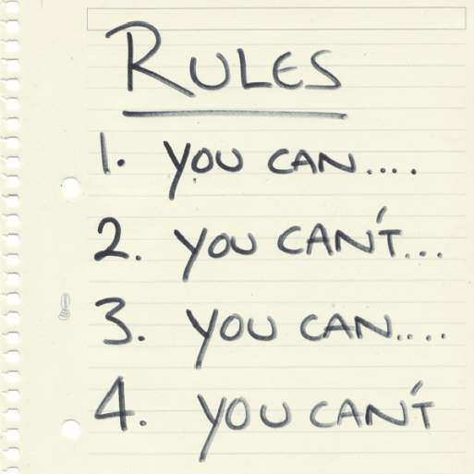
Permit Conditions
Individual Permit
  Detailed mitigation plan required
  Permit conditioned to include by reference the mitigation plan or
  Permit conditioned to require to objectives, performance standards, and monitoring, financial assurances and long-term management provisions
General Permit
  Conceptual mitigation plan acceptable, detailed plan preferred
  Conditioned to require approved mitigation plan prior to conducting work

Slide 21

Monitoring Plan
Regulatory Guidance Letter 08-03
Project Overview
  Who, What, When, Where and Why plus and executive summary of the following information
Requirements
  Identify the requirements of the mitigation plan and evaluate whether the mitigation is meeting those requirements
Summary Data
  Data to substantiate the success and/or potential challenges associated with the compensatory mitigation project.
Maps and Plans
  Vicinity maps, site maps, as-builts etc.
Conclusion
  If performance standards are not being met, then discussion of adaptive management strategies should be included in this section.

Slide 22

So You Want To Be A Banker
New rule has standards and requirements as well as the procedure for establishing and operating a Mitigation Bank and/or In-Lieu Fee Program
Must have an approved instrument signed by the district engineer and sponsor
Rule provisions intended to make make the instrument approval process more efficient
Timeline with milestones to provide predictability and accountability in the instrument approval process.
Establishes the Interagency Review Team for review of proposal
  Also establishes a dispute resolution process for the IRT

Slide 23
Instrument Process*
Draft Prospectus & Interagency Review
Formal Prospectus, Public notice and comment process & Interagency Review
Draft Instrument & Interagency Review
Final Instrument & Interagency Review
Instrumented Bank or In-Lieu Fee Program
Issuance of credits in accordance of the Instrument
*The goal is to do this in 225 days, that’s a lot of
interagency review for 225 days.

Slide 24
What I have provided for you today is the laws, rules and regulations governing the Corps’ compensatory mitigation program*
*Your experience with the Corps may differ

Slide 25

Tune in Next Time
For the hero’s further adventures

